Slide 1

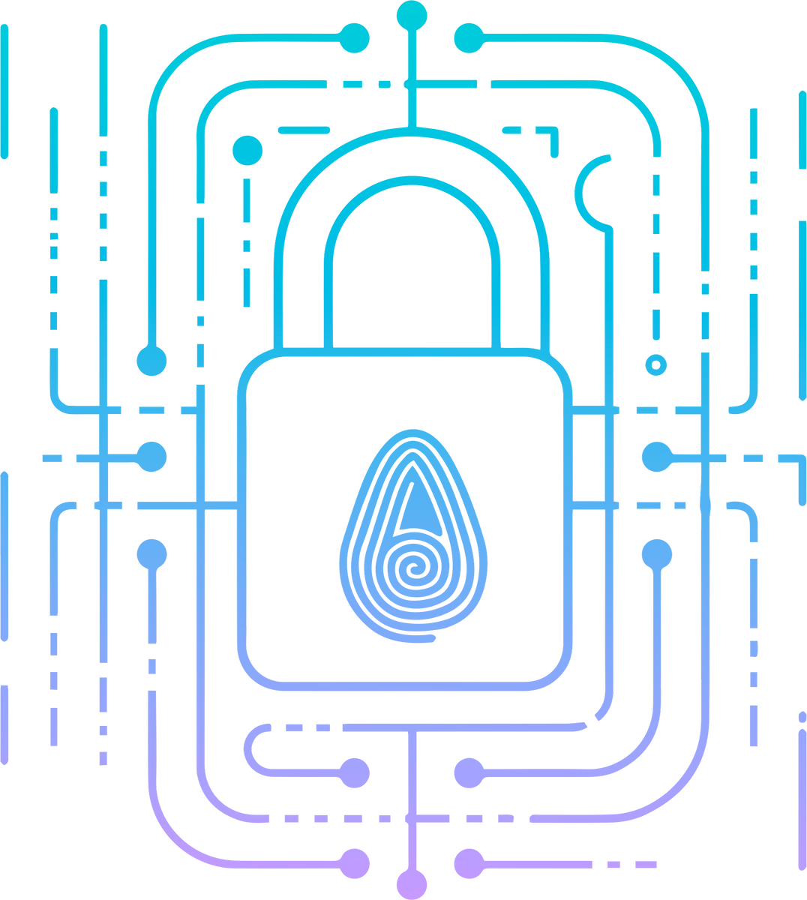

DEEP FAKE
A New Cybersecurity Threat

Slide 2
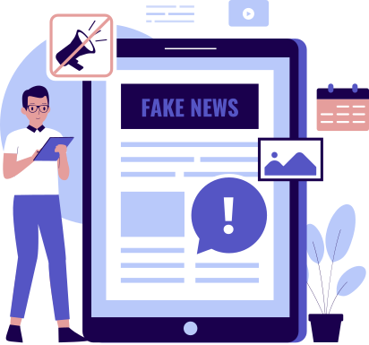


WHAT IS A DEEPFAKE?
Deepfake = “Deep Learning” + “Fake”
Deepfakes are AI-generated fake videos, images, or audio that appear real.
Created using machine learning algorithms (e.g., GANs).
Often used to impersonate real people — politicians, CEOs, celebrities, etc.

Slide 3
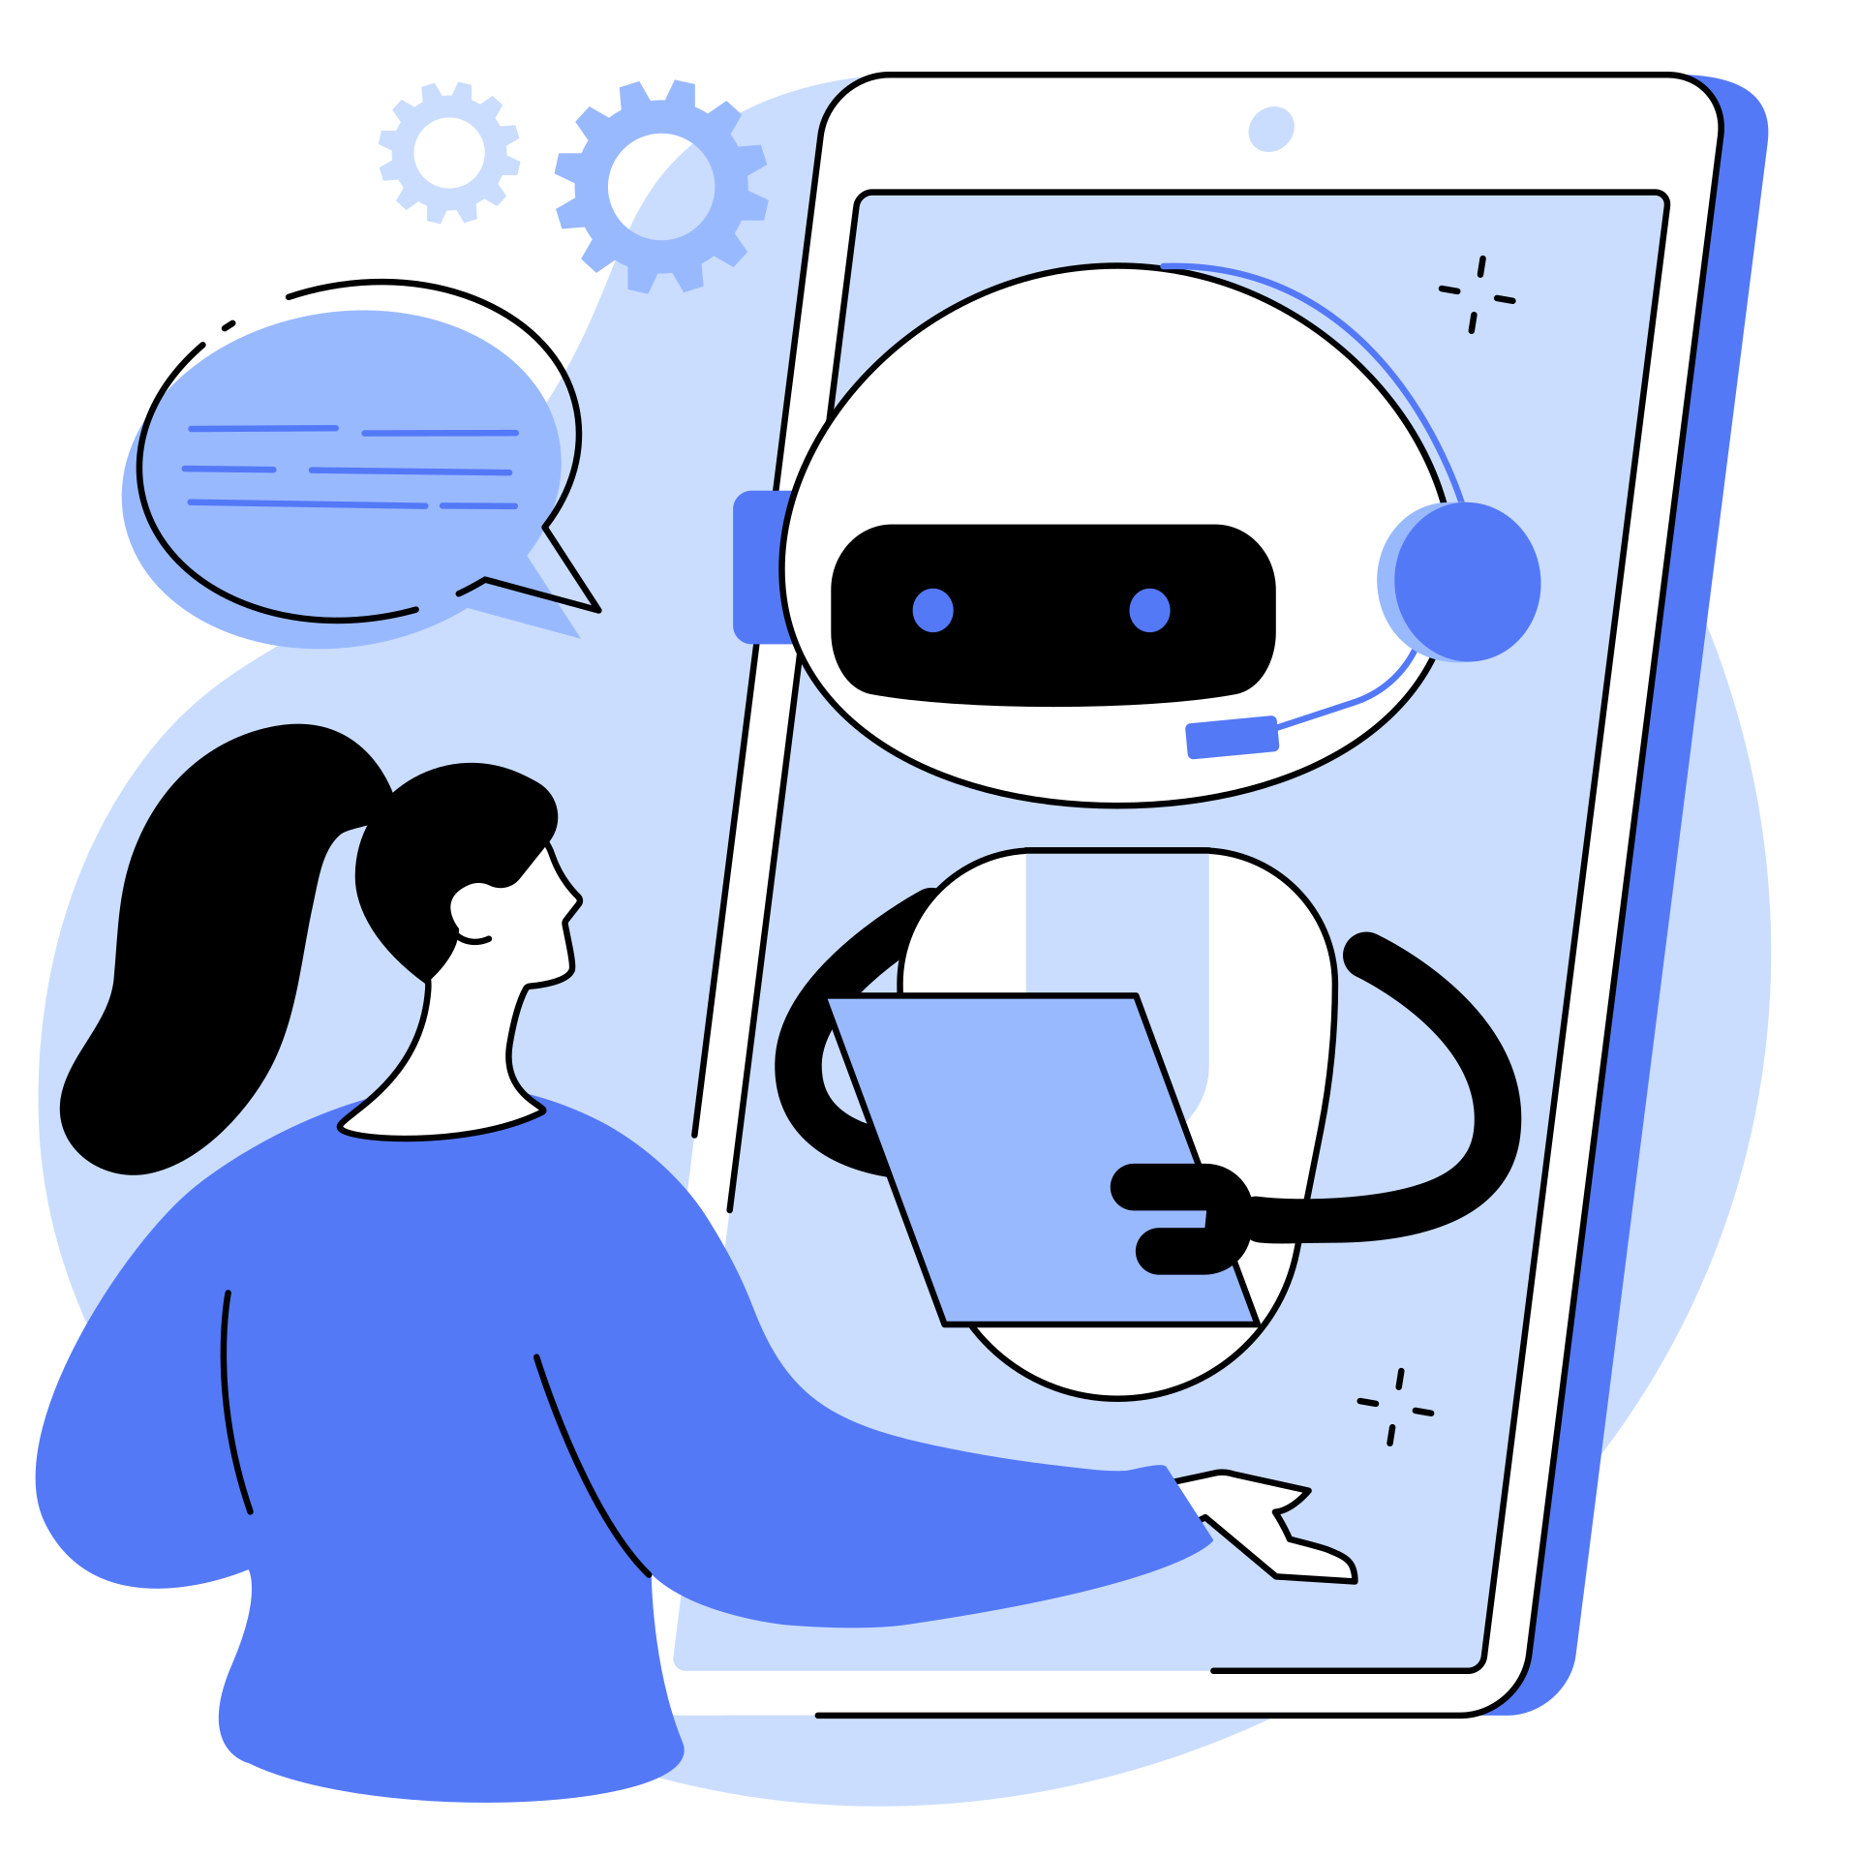
HOW DEEPFAKES ARE USED IN CYBER ATTACKS
1.
Voice Phishing (Vishing): Fake CEO voice used to scam employees.
Fake Video Calls: Attackers pretend to be managers in Zoom/Google Meet.
Phishing Emails with Deepfake Attachments
Blackmail & Extortion: Using fake videos to threaten victims
Misinformation Campaigns – political or social chaos.

Slide 4
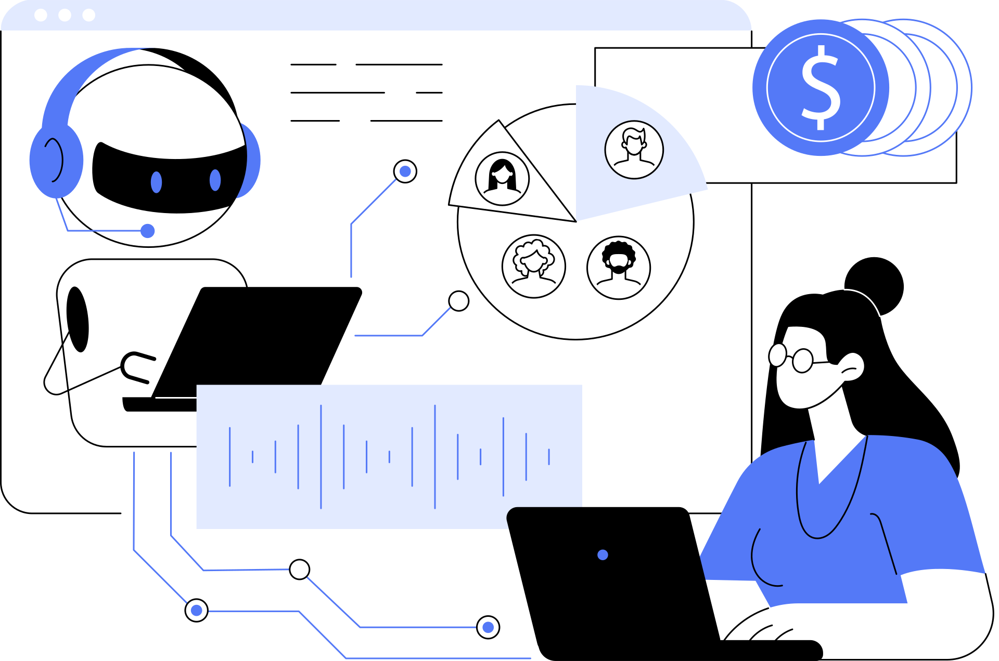
WHY DEEPFAKES ARE SO DANGEROUS
Hard to detect without AI tools.
Can destroy a person's reputation in seconds.
Used in cyber scams, financial frauds, and election manipulation.
Damages public trust in online content.
Increases the difficulty of verifying digital identity.

Slide 5
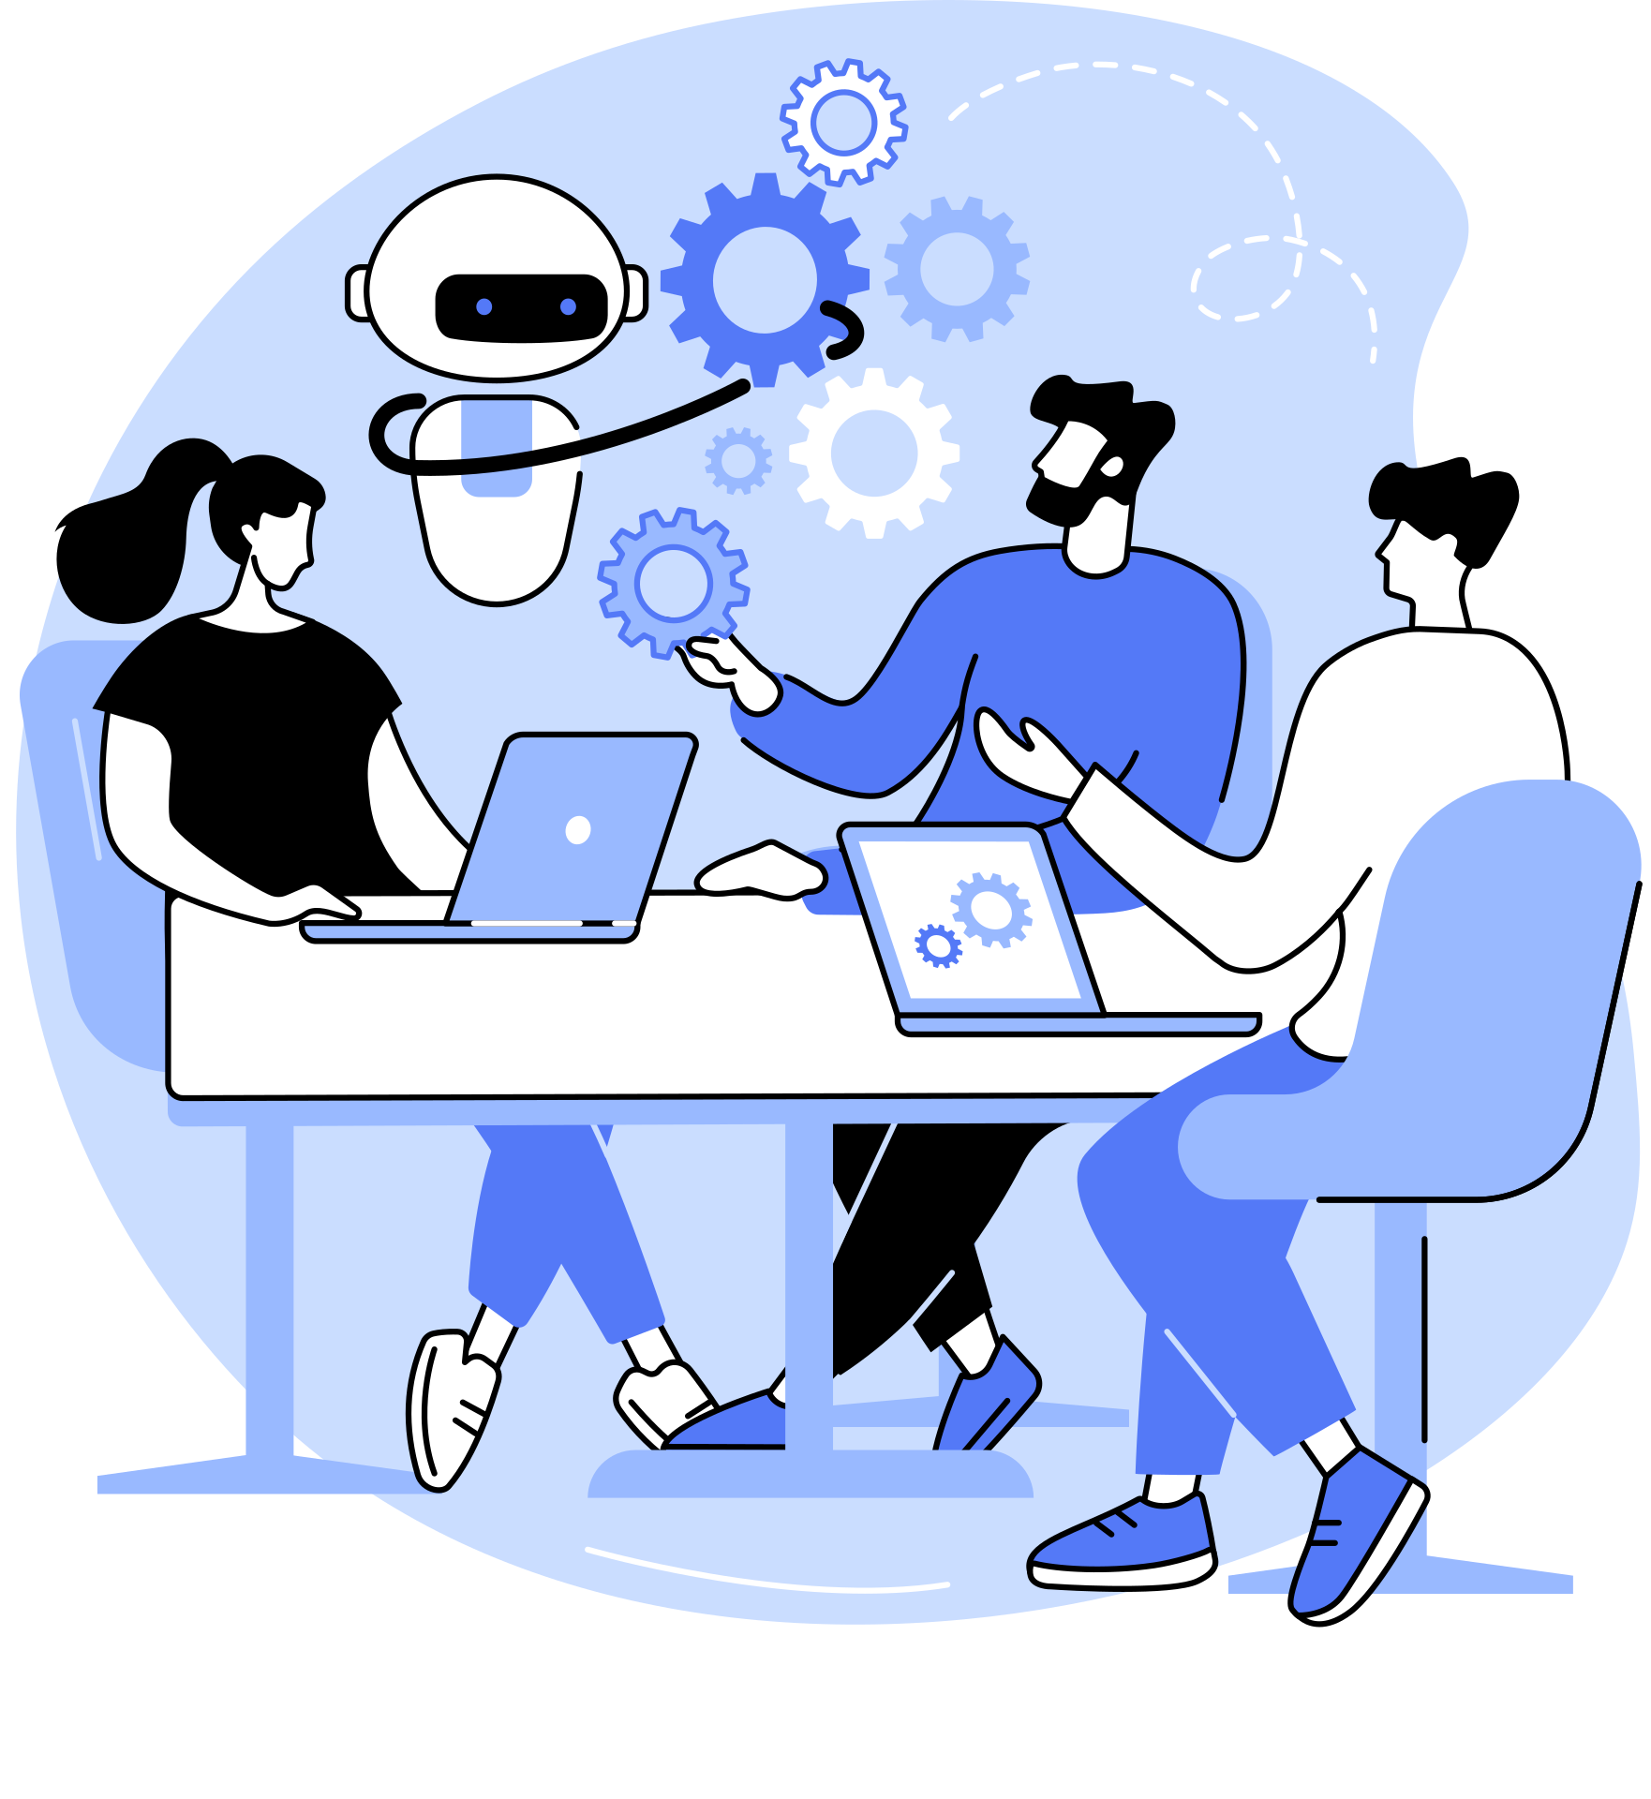
REAL-WORLD EXAMPLES OF DEEPFAKE ATTACKS
Business Scam (2024):
Fake voice of CFO tricked an employee into wiring funds to a
hacker’s account.
Fake Celebrity Endorsements:
Deepfakes used to show celebrities promoting scam products.
Political Deepfakes:
Fake speeches created to mislead the public before elections.

Slide 6
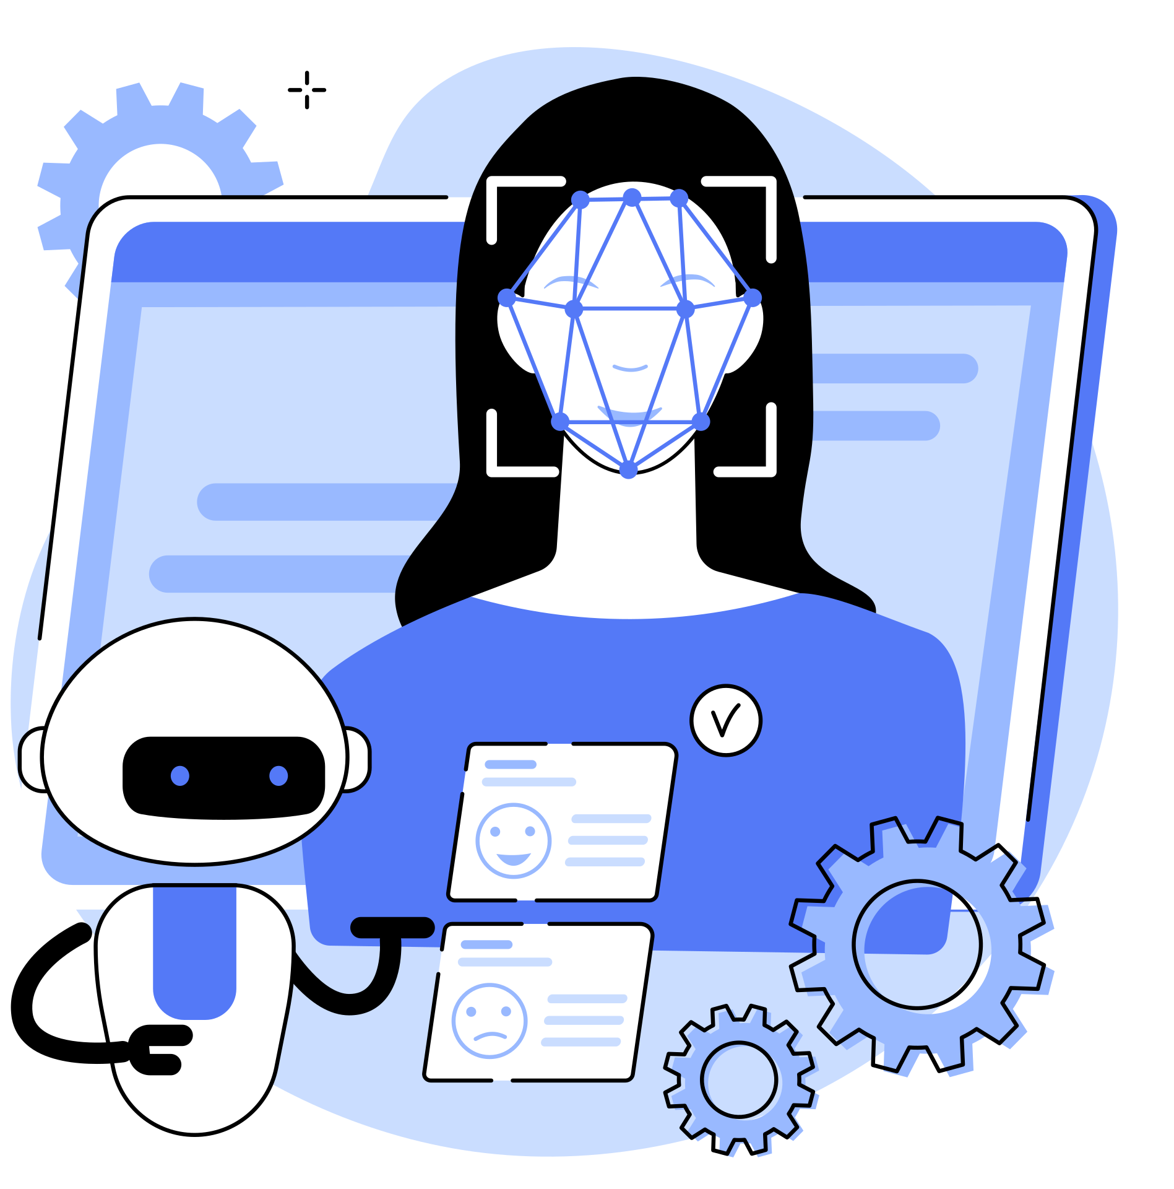
HOW TO DETECT & PREVENT DEEPFAKES
Detection Techniques:
AI-based deepfake detectors (e.g., Microsoft Video Authenticator)
Look for unnatural blinking, lip movement, shadow inconsistency
Prevention Tips:
Don’t blindly trust audio/video without verifying source.
Always use 2FA (Two-Factor Authentication).
Verify instructions given via video call or voice message.
Raise awareness in workplaces.

Slide 7
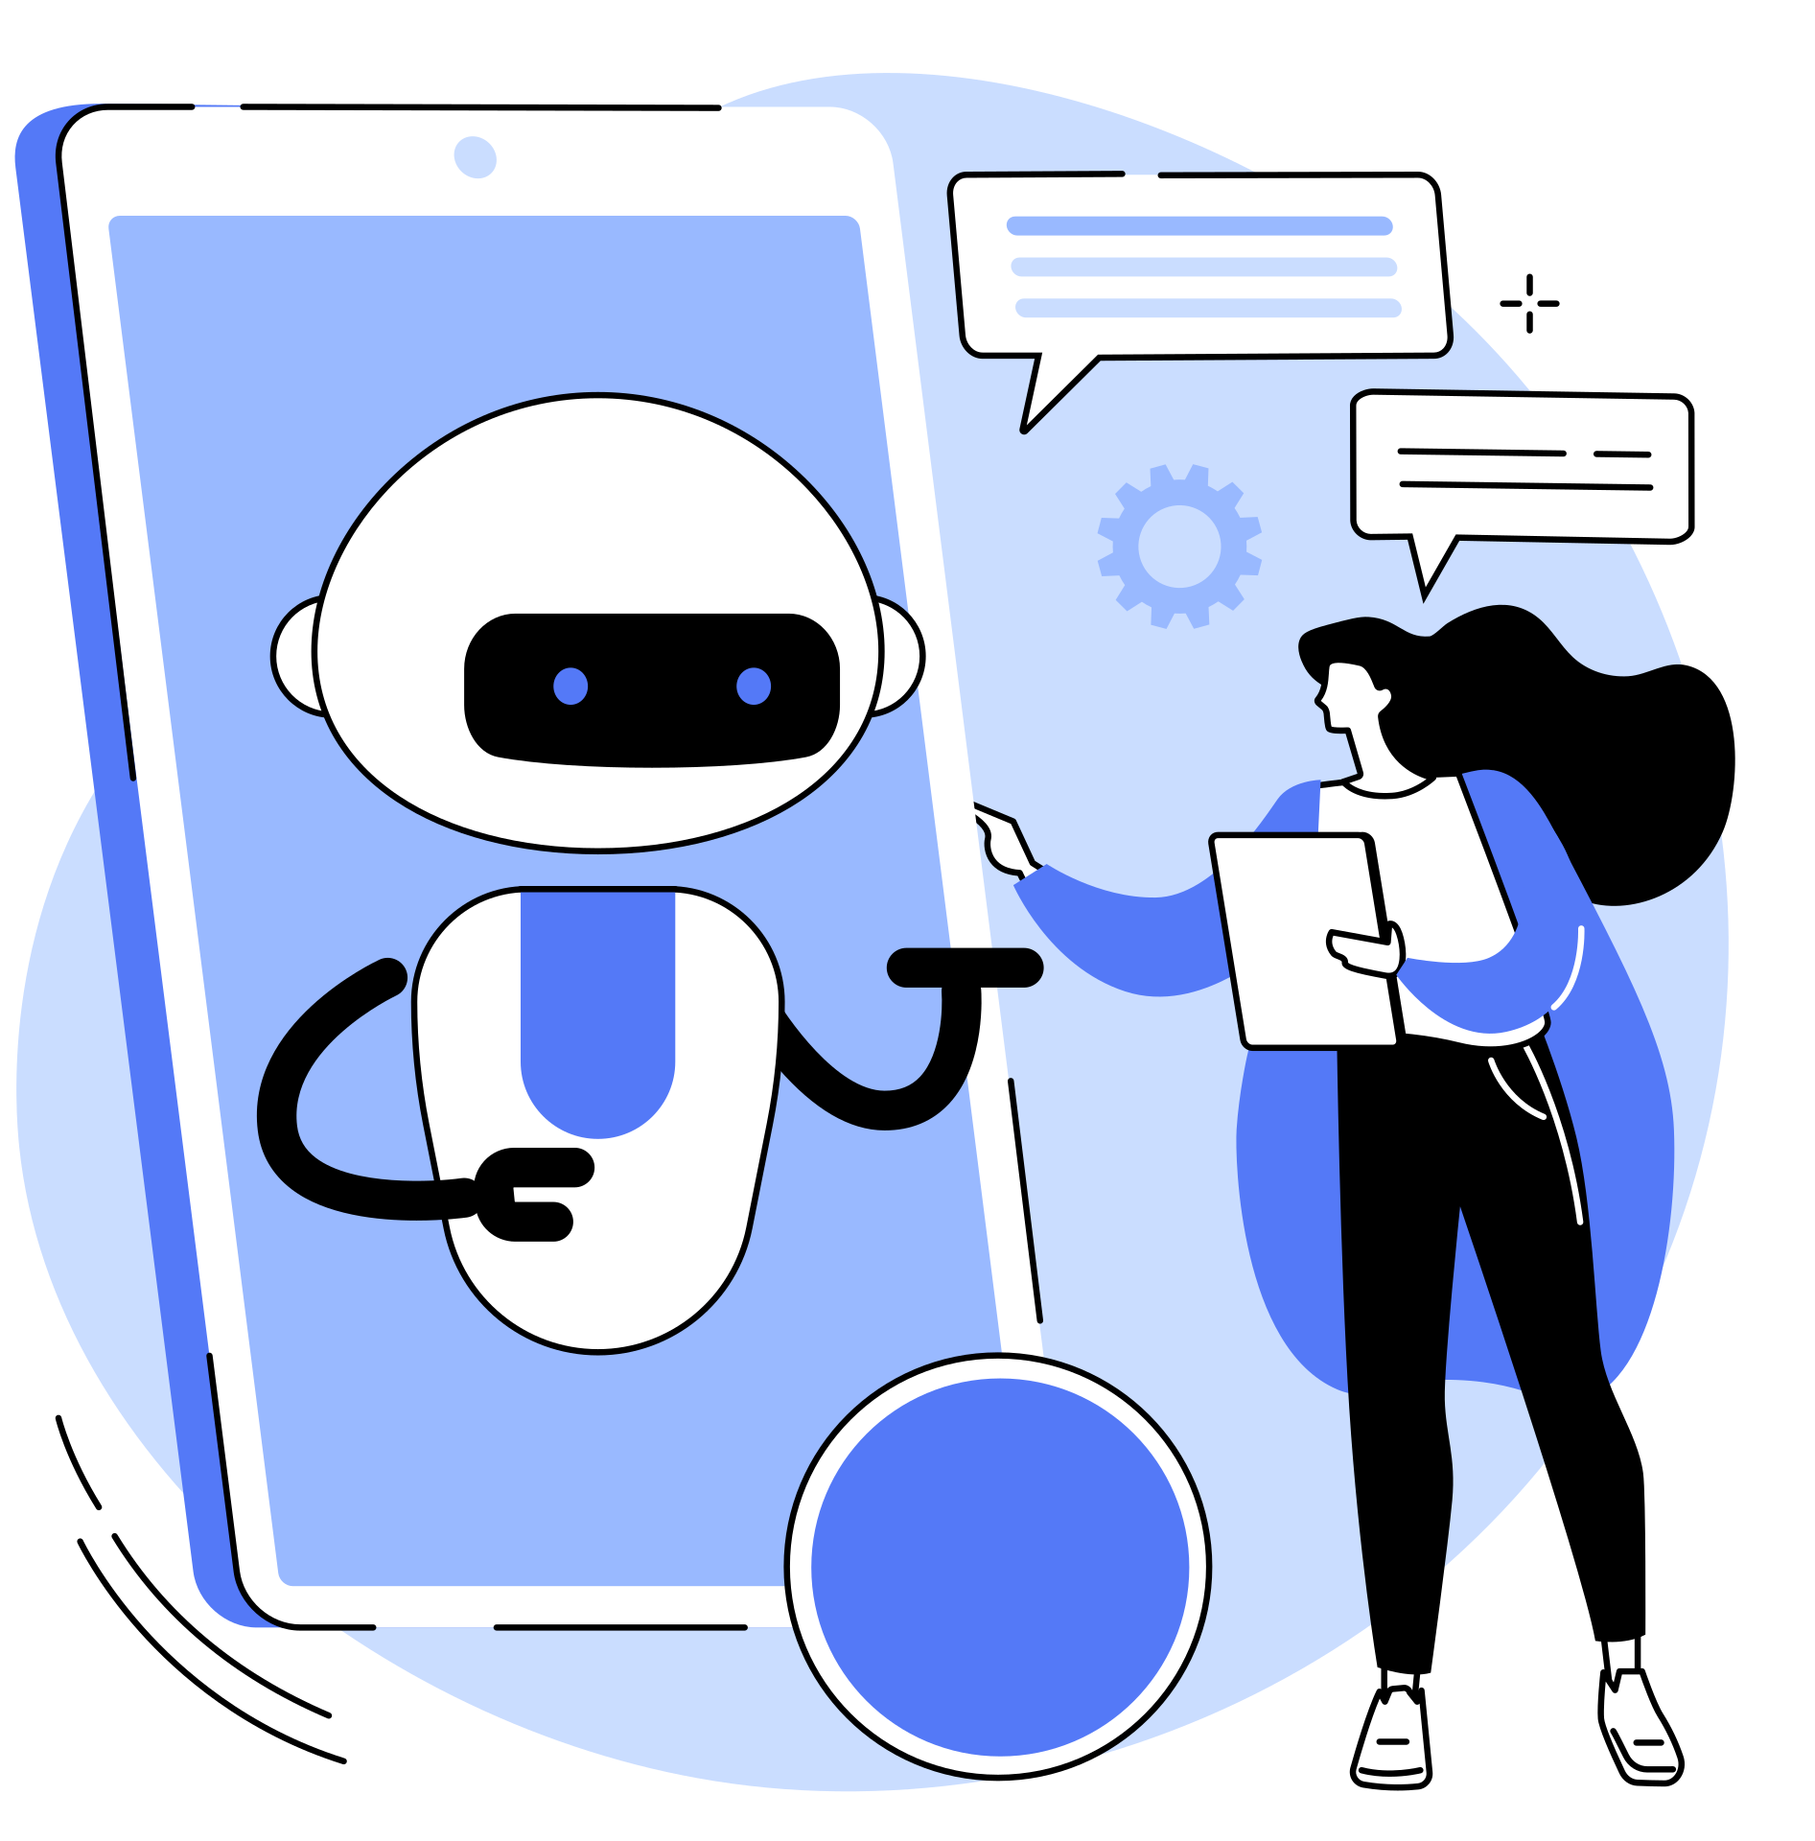
CONCLUSION
Deepfake is no longer just a joke — it’s a real cyber threat.
It affects our security, privacy, and trust.
Only way to stay safe is through education, awareness, and AI detection tools.
3.

Slide 8


